Slide 1
Assessment of Car Accident severity and building of ML Models

Slide 2
Business Problem
Increase in road accidents a huge concern for the general public and the governing body in Seattle area
In order to control collisions, it is utmost important to find the resolution for this. Below are the problems to be addressed:
- Which section of the automobile should be focussed to improve safety in automobiles so that collision can be avoided?
- What type of collisions are frequent and of what severity?
- What and when the changes should be made in relation to infrastructure development?
- In what type of weather conditions maximum collisions have been recorded?
- Were Speeding and weather variables contribute towards collision?
- Which severity was at peak at different weather conditions?
- What are the major reasons behind collision?

Slide 3
Target Audience
• General Insurance companies
• Traffic/Transportation ministry
• Automobile Companies

Slide 4
Data Acquisition and Cleaning
Dataset collected from the Seattle Police department in an effort to reduce the frequency of car collisions in a community
Independent Variables assessed for correlation with target variable (Severity Collision):
- Weather Conditions: A description of the weather conditions during the time of the collision
- Road: The condition of the road during the collision
- Junction Type: Category of junction at which collision took place
Python was used for data exploratory and cleaning purpose

Slide 5
Data Acquisition and Cleaning
Below are the data points which I dropped as they were highly correlated or biased:
Whether or not collision was due to inattention
Whether or not a driver involved was under the influence of drugs or alcohol
Whether or not the pedestrian right of way was not granted
Whether or not speeding was a factor in the collision
Whether or not the collision involved hitting a parked car

Slide 6
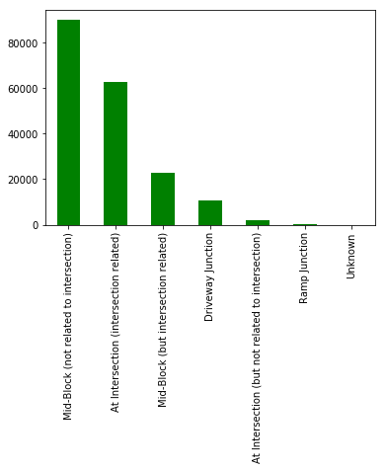
Junction Type Vs Collisions

Slide 7
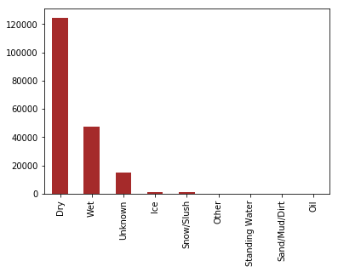
Correlation between Road Conditions and Collisions
What and when the changes should be made in relation to infrastructure development?

Slide 8
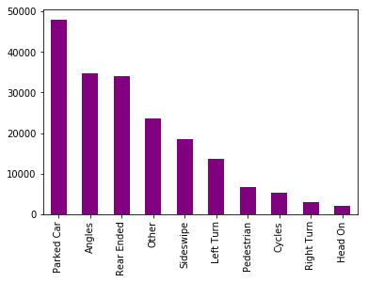
Collision Type Analysis
Parked Cars are collided
most followed by collisions
at angles and Rear Ends.

Slide 9
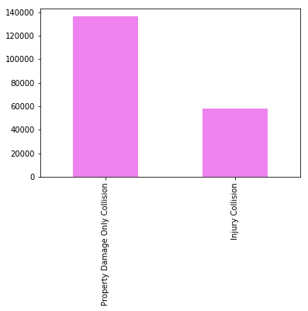
Correlation between Severity and Collisions
What type of collisions are frequent and of what severity?

Slide 10
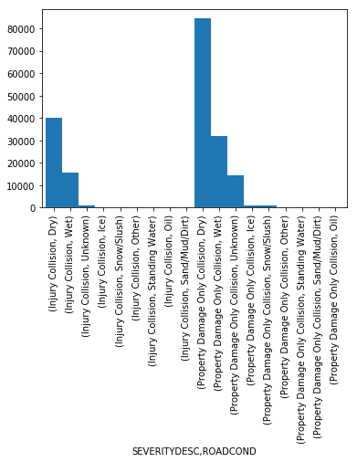
Correlation between Road Condition ,Severity and Collisions
It can be observed that collisions
where property was damaged are
most when the road conditions were dry in comparison to when they were in wet conditions
Likewise, collisions involving injury and threat to life are most when road condition is dry

Slide 11
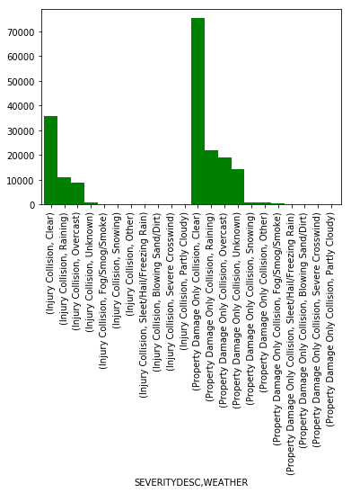
Correlation between Weather, Severity and Collisions
It can be seen that collisions where only property damage is involved is most when weather is clear similar to when collisions also include injury collision.

Slide 12
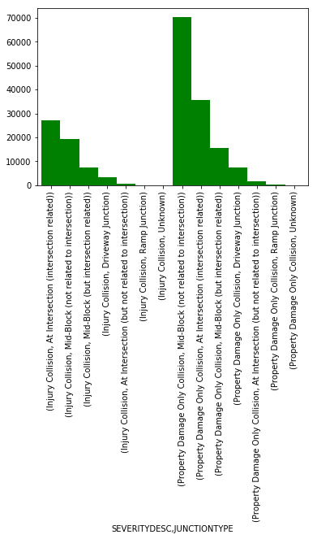
Correlation between Severity description ,junction type and collisions
This figure conveys that most collisions involving only property damage are at road’s mid-block or at intersection when compared to those collisions which include injury as well.

Slide 13
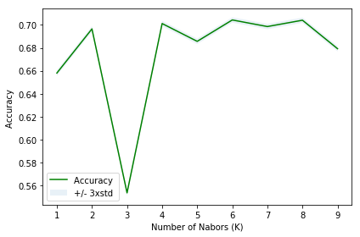
Classification Models
The best accuracy was KNN model with 70.43% accuracy with k= 6
After evaluating different machine
Learning models, we find that
KNN model has highest accuracy
When k-neighbours are 6 in numbers.

Slide 14
Conclusion
- Automobile companies can use the results to identify opportunity to improve safety in vehicle to prevent collisions specially mid-block and at intersection
- Insurance companies can modify their underwriting rules and make changes in product norms or make exclusions on the basis of data of maximum collisions to reduce risk
- Road Transport ministry can focus more on reasons of collision and importance of road maintenance
Companies and governments can maximize revenue by:
By reducing risk and claims as much as possible
In order to show the better results to the general public during elections by decreasing collision in no.s in coming years

Slide 15
Complimentary Data for better research
Complimentary data that would have helped in research:
Data about the timeframe of weather conditions in the area of Seattle
Data about infrastructure status during different weather conditions

